Slide 1
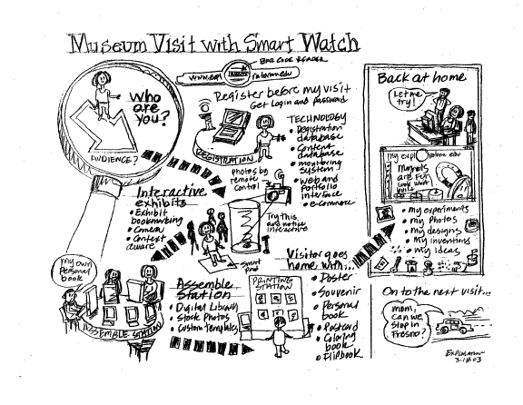
Sketching User Interfaces CSCI 5839 – Fall 2021

Slide 2
This week (and next)
Finally getting into creating interfaces 🎉

Slide 3
Big ideas
Focus on problem solving, not tools
Learn to represent ideas across different tools and representations
Learn to consider and evaluate variants

Slide 4
Breaking it down
Today: General intro to sketching, practicing single (static) sketches
Wednesday: Sketching sequential actions
Next Mon: Sketching interaction via paper prototypes
Next Wed: Creating clickable prototypes with Figma

Slide 5
We are here
User research
Ideate
Prototype
Evaluate
Done!
requirements,
user perspectives
ideas for UI, sketches
testable prototypes
refined prototype
Notes:
Research is ongoing, takes time
Now we have the opportunity to explore some ideas, work toward a prototype

Slide 6
Sketching

Slide 7
Why sketch
We want to be able to quickly articulate, share, and test ideas
People (teammates, clients) react differently to sketches than to written or spoken descriptions
Generate ideas based on your understanding of problem, not what tools make easy
Notes:
And generally in a better way

Slide 8
Finding gaps in your ideas
By making your ideas concrete, you have to consider and decide
Layout: what can fit on this screen?
Size: How much space can each element use?
Order: What order does this happen in?
... and other details
Notes:
In our mind it’s easier to overlook these things

Slide 9
Sketching vs. dragging stuff around
It’s important to be able to start from a blank sheet of paper
Shows that you have an understanding of what you’re working with
Demands attention to detail
Ability to break rules to try new things
Notes:
If you feel like you know how to do this, then you can cut corners

Slide 10
You have to do it
In the future you may choose other prototyping tools…
But you need to know how to sketch on paper

Slide 11
Sketch early and often
Think of sketching as something you can do quickly, with no setup, and redo easily
Making changes only gets more difficult as time goes on

Slide 12
Redraw it
Many situations where we have an OK sketch but there are some flaws
Or we want to try another variation
Or we drew a sketch on our iPad but need to pass it to someone else
Solution: Redraw it, basically every time
Each sketch is a little moree practice
Practice in this class – aim for ≥100 sketches

Slide 13
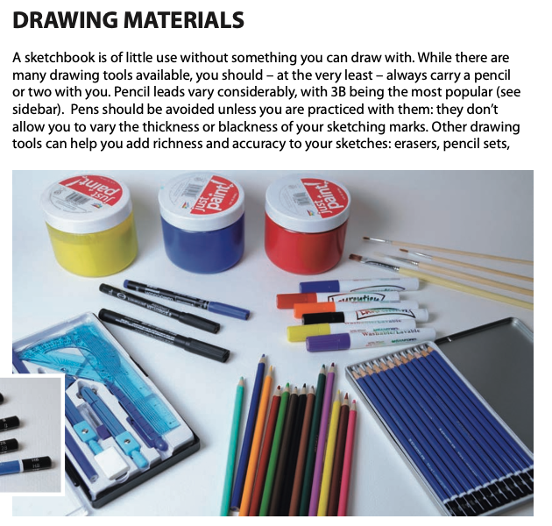
Sketching tools
Have plenty of paper
Including something shareable
It’s good to have multiple drawing tools (different colors, highlighters)
Beyond that, use tools that you enjoy
Notes:
Image from Geenberg et al, “Sketching Usre Experieences”, p.16

Slide 14
What, when, how to sketch
As we saw in reading, there are many prototyping methods
No easy answers about which method is best for your project, where to focus
You need to be aware of the current state of your project, where your ideas need the most attention and iteration

Slide 15
Goal of sketching (at this stage)
Get ideas out of your head and onto a page (or screen)
Represent your ideas clearly enough that someone else can understand them
Be aware of potential issues like sizing, alignment, spacing…
Sketch everything multiple times
Notes:
Think about this not as making the interface, but as a way of thinking through it

Slide 16
Some terminology
Low fidelity vs. high fidelity prototypes
Prototypes can be made using simple tools, leaving details out (“low fi”) or using complex tools, with more details included (“high fi”)
Divergent vs. convergent sketching
Early on, we want to try out many different ideas (divergent sketching)
Later, we want to explore smaller variations in our idea (convergent sketching)

Slide 17
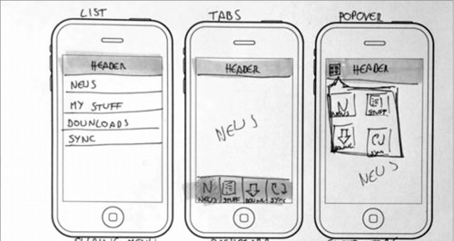
Divergent sketching
Notes:
No one should ever say, at this stage, whoa, that idea is TOO different

Slide 18
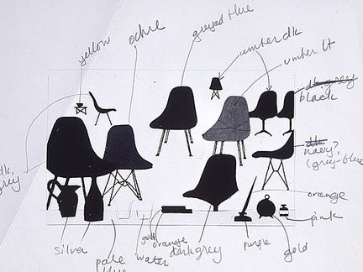
Convergent sketching
Charles Eames (dwr.com)

Slide 19
Sketching today
~4 minutes setup
We’ll go through a series of sketching exercises (I’ll do them too)
Many are from (or inspired by) Sketching User Experiences: the Workbook
We’ll turn them in later in the week
If you are comfortable with this already, feel free to do more / more complex stuff
s

Slide 20
Example
The user needs to indicate their home’s location for a meetup app

Slide 21
What did you come up with?
Part of the trick here is to frame the problem at the right level of detail
High enough to have multiple possibilities, but concrete enough to work on
“How to indicate location” vs. “How to enter address”

Slide 22
Deciding what to sketch
For now, focus on one “screen” or interaction
vs. storyboards and flow diagrams for showing sequences
Draw everything relevant
May just be the screen (but it’s often useful to include scale)
For many applications, need to provide more context (device, body parts, multiple users/devices)
Notes:
For example, on a smartwatch size is very important

Slide 23
Sketching process
Divergent sketching
Explore possible ideas
Convergent sketching
Get the details right
Iterate

Slide 24
Overcoming inertia
For most tasks, we probably know one way to do them
We can sleepwalk through the creation of many interfaces (e.g. design a messaging app)
Our goal should not just be to create a solution, but to understand the solution space and tradeoffs
We want to be open to making things more fun, interesting, accessible (by whatever definition)
We want to be ready for changes in technology

Slide 25

Sketching physical objects
Jeff Hawkins’ (Palm) block of wood
Notes:
Physical prototyping
http://idintern.wordpress.com/2011/02/03/business-realities/s

Slide 26
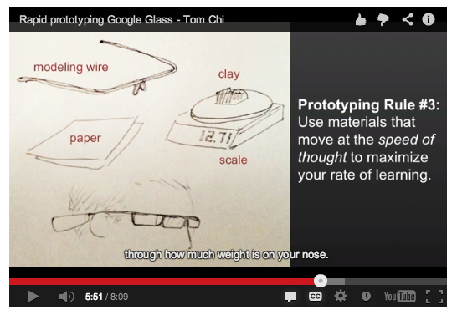
Google Glass in chopsticks
http://glass-apps.org/google-glass-prototype

Slide 27
Sketching for non-visual interfaces
When possible, use physical models
For speech, use dialog trees (or tools like Dialogflow)
Focus more on similarities
What information are you presenting when?
In what order do operations occur?
How do we convey what’s possible?

Slide 28
Personal goals for sketching
Be able to jump into a sketch without hesitation or planning (make it easy to do)
Sketch clearly enough that someone else can understand it (not necessarily realistically)
Understand how much space things take up
Be able to break out of your first idea and explore other options
Capture ideas as they come up (carry a sketchbook?)
Save your sketches (to show all the cool work you’ve done)

Slide 29
You have to practice
You have to practice
You have to practice
Notes:
You can’t actually do this well if when you’re doing it is the first time you’ve ever done it

Slide 30
Seriously, you should practice
Good goal for this class: 100 sketches

Slide 31
Sketching tips
Practice drawing common elements
Devices, UI elements, people
Can choose your own style, not necessarily true to life but understandable
Treat yourself to nice sketching materials
Treat sketches as disposable, don’t be afraid to redo them
Be thoughtful about where to focus
Notes:
http://brylie.gnumedia.org/storyboarding/
Why are star people better than stick people?

Slide 32
More practice
Character profile generator for a CS student
What needs to go in it?

Slide 33
Even more practice
Remember the Apple TV remote
How can we write code using this remote?
Inputs: 4 way swipe, click, 6 buttons, accelerometer
Put a photo on your blog

